Slide 1

Customer Shopping Behavior Analysis
Uncovering insights from transactional data to guide strategic business decisions.

Slide 2

Project Overview
1
2
Data Analysis
3,900 purchases across categories.
Goal
Uncover spending patterns, segments, preferences.
3
Strategy
Guide strategic business decisions.

Slide 3

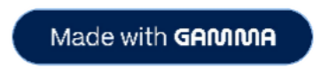
Dataset Summary
Rows: 3,900
Columns: 18
Missing Data: 37 values in Review Rating
Customer Demographics
Age, Gender, Location, Subscription Status
Purchase Details
Item, Category, Amount, Season, Size, Color
Shopping Behavior
Discount, Promo, Previous Purchases, Frequency, Review, Shipping

Slide 4

Exploratory Data Analysis (Python)
Data Cleaning
Missing values (Review Rating median), column standardization (snake_case).
Data Loading & Exploration
Pandas import, `df.info()`, `.describe()`.
Consistency & Integration
Dropped `promo_code_used`, loaded to PostgreSQL.
Feature Engineering
Age groups, purchase frequency days.

Slide 5
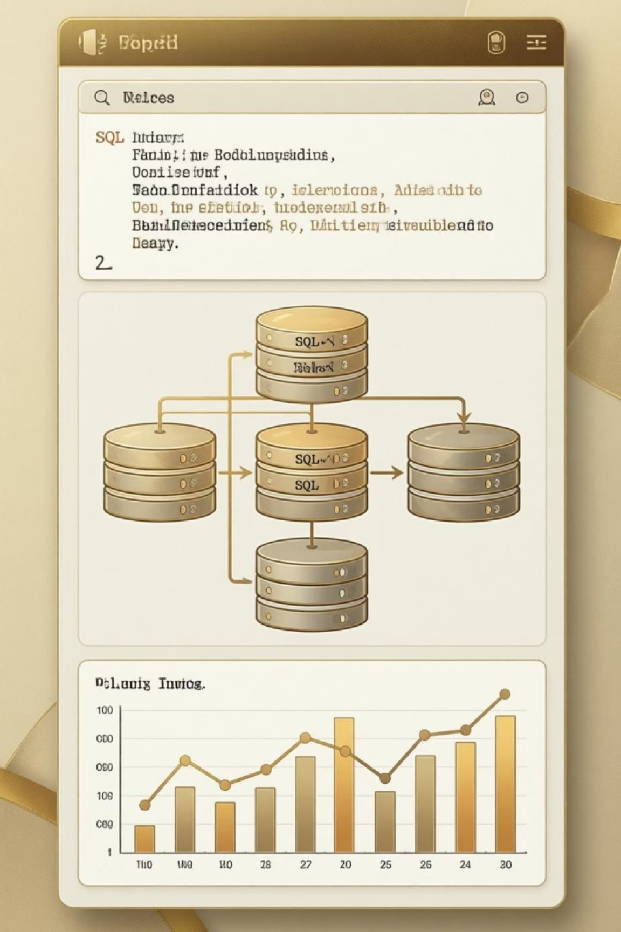
Data Analysis (SQL) - Key Business Insights
1
Revenue by Gender
Female: $75,191, Male: $157,890
2
High-Spending Discount Users
839 customers spent above average with discounts.
Top 5 Products by Rating
Gloves (3.86), Sandals (3.84), Boots (3.82), Hat (3.80), Skirt
(3.78)
3
4
Shipping Type Comparison
Standard: $58.46, Express: $60.48

Slide 6
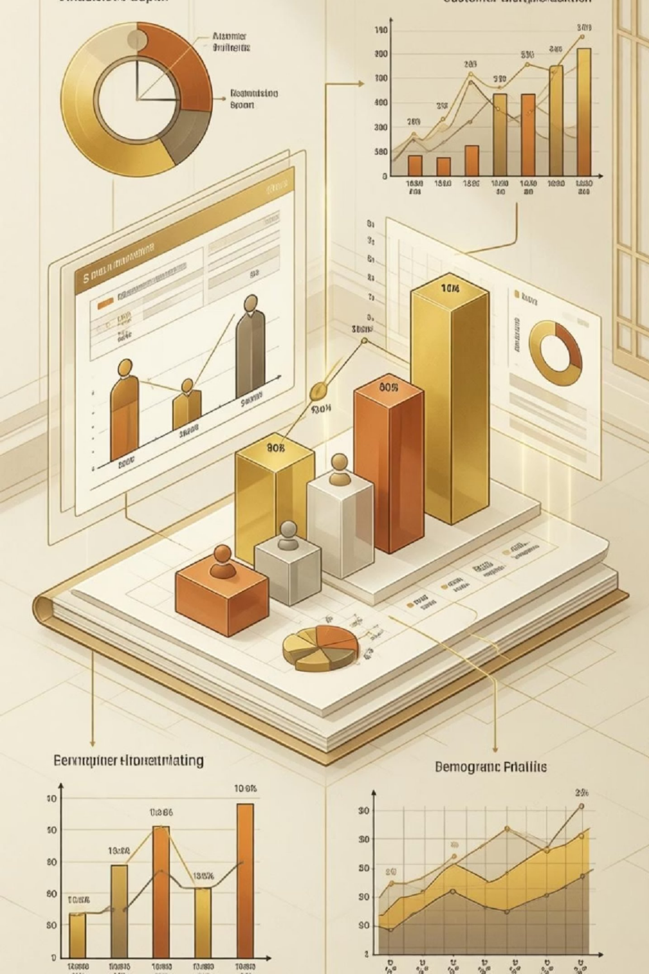
Data Analysis (SQL) - Deeper Dive
Subscribers vs. Non-Subscribers
Subscribers: 1053, Avg Spend: $59.49, Total Revenue: $62,645
1
Non-Subscribers: 2847, Avg Spend: $59.87, Total Revenue: $170,436
Discount-Dependent Products
Hat (50%), Sneakers (49.66%), Coat (49.07%), Sweater (48.17%), Pants
(47.37%)
2
3
Customer Segmentation
Loyal (3116), Returning (701), New (83)
4
Revenue by Age Group
Young Adult: $62,143, Middle-aged: $59,197, Adult: $55,978, Senior: $55,763

Slide 7

Top Products per Category
Accessories
Jewelry (171)
Sunglasses (161)
Belt (161)
Clothing
Blouse (171)
Pants (171)
Shirt (169)
Footwear
Sandals (160)
Shoes (150)
Sneakers (145)
Outerwear
Jacket (163)
Coat (161)

Slide 8
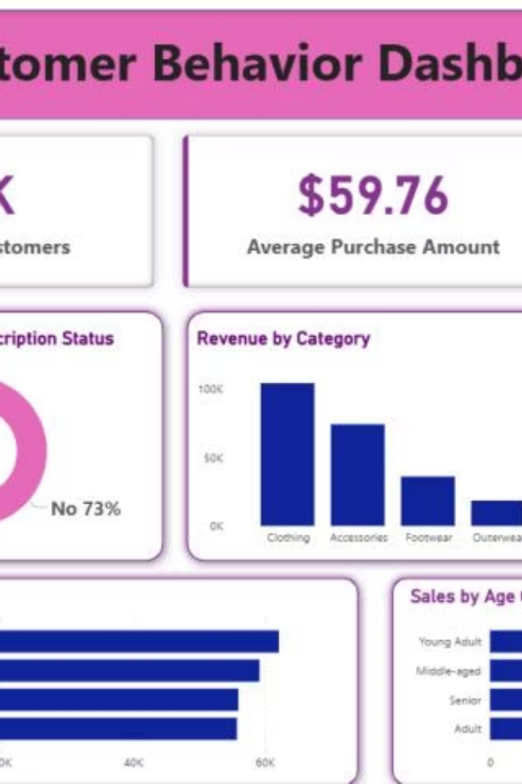
Dashboard in Power BI
Interactive visualizations for key insights.
3.9K
Customers
$59.76
Avg. Purchase
3.75
Avg. Review

Slide 9
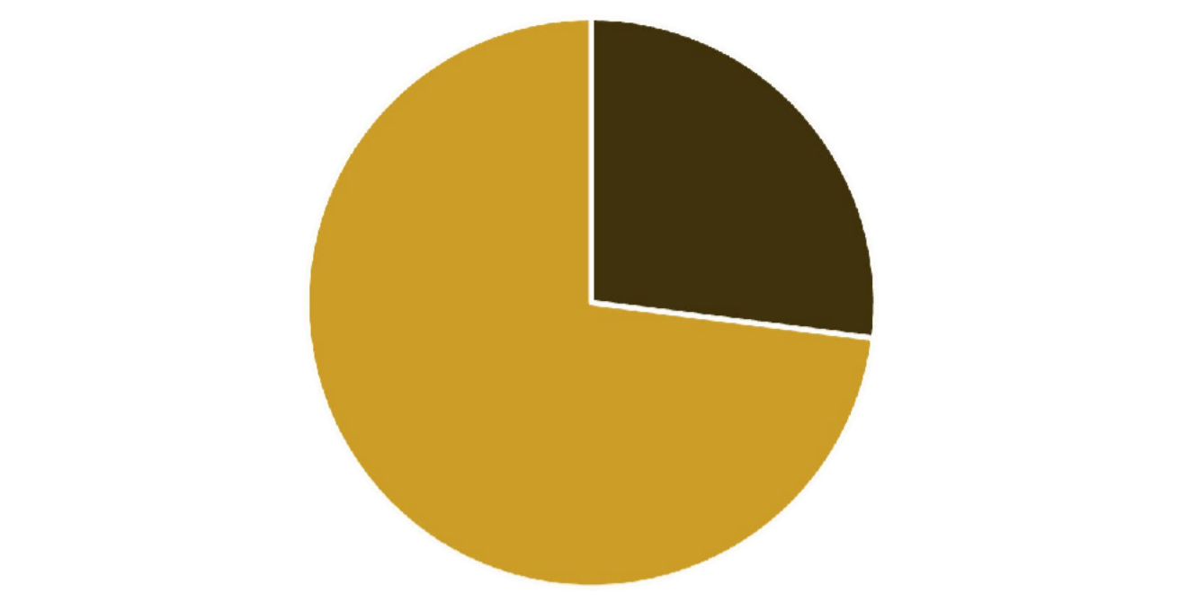
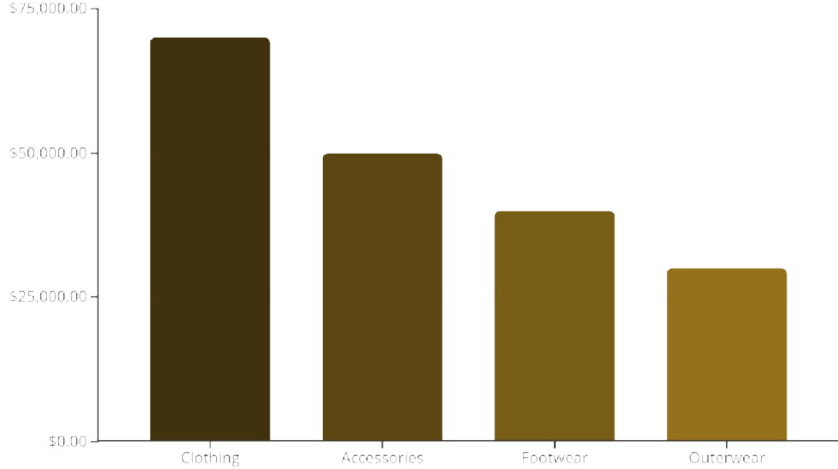


Dashboard Visualizations
Customer Subscription
Revenue by Category
Yes No

Slide 10





Business Recommendations
Boost Subscriptions
Promote exclusive benefits.
Customer Loyalty
Reward repeat buyers.
Review Discount Policy
Balance sales with margin control.
Product Positioning
Highlight top-rated & best-selling products.
Targeted Marketing
Focus on high-revenue age groups & express shipping users.

